Slide 1


Slide 2
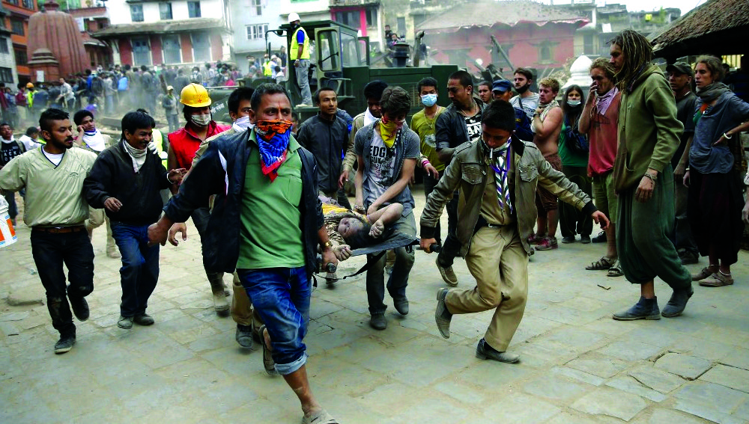

Movimiento Scout
y Acción Humanitaria
PROGRAMA DE JÓVENES

Slide 3
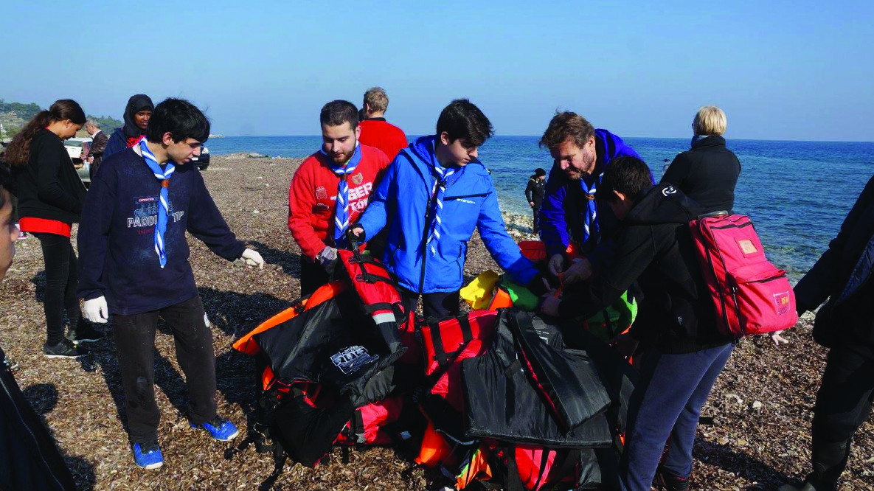
Contenido
Introducción
Antecedentes históricos
Visión general de la Acción Humanitaria en el Movimiento Scout
Enfoque de la OMMS para Acción Humanitaria
Lineamientos para Acción Humanitaria de la OMMS
El Modelo de Servicio
Siguientes pasos

Slide 4
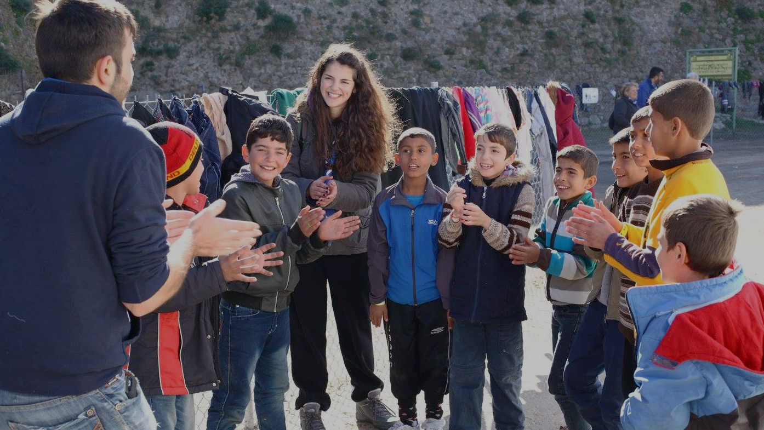
Al final de esta presentación, el participante podrá:
Entender el vínculo entre la Acción Humanitaria y el Movimiento Scout
Obtener una visión general de las iniciativas de los Scouts en esta área
Entender el enfoque de la OMMS y los próximos pasos

Slide 5
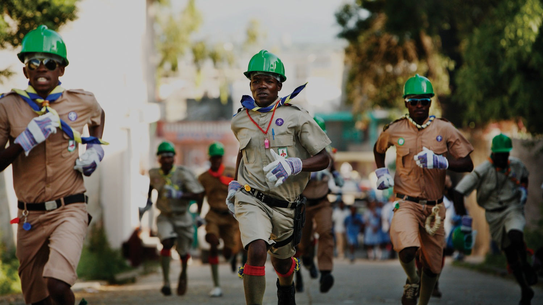
¿Qué es Acción Humanitaria?
Notes:
The objectives of humanitarian action are to save lives, alleviate suffering and maintain human dignity during and in the aftermath of man-made crises and natural disasters. It also aims to prevent and strengthen preparedness for when such situations occur. Humanitarian action should be guided by the following principles:
Humanity refers to the provision of helping other people at all time, wherever the need exists, with the purpose to protect and respect all human beings.
Impartiality means without distinction of gender, origin, race or creed.
Neutrality means we do not choose sides or favour any religious or ideological group.
Independence refers to the need to be non-political and autonomous from other influences.

Slide 6
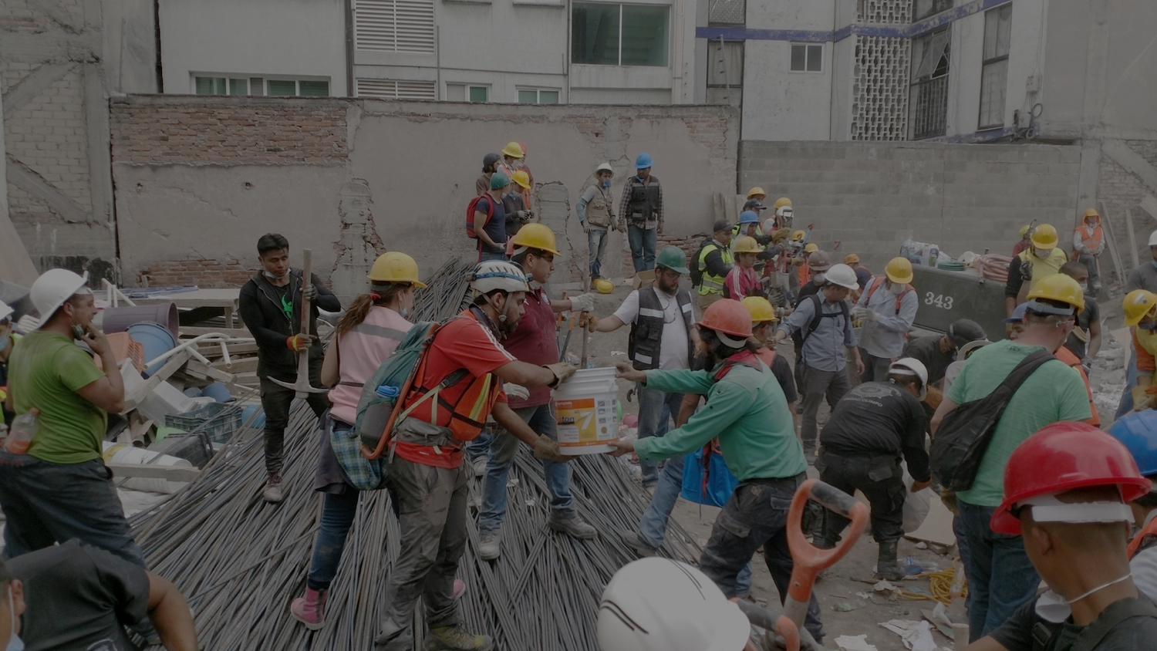
¿Por qué traer eso
al Movimiento Scout?
Notes:
Scouting has humanitarian values at its core. While Scouting is not a humanitarian organisation, Scouts have been involved in humanitarian action for more than 100 years, simply by following the fundamental Scout principle of Duty to others.
Furthermore, Prevention and preparedness are crucial components of humanitarian action. Scouting contributes the most to those areas, through the education of young people, giving them skills for life and enabling them to be prepared as active citizens of more resilient communities.
Climate change, urbanization, migration, in addition to natural hazards and conflicts have caused more frequent and destructive disasters. Scouts often get involved spontaneously as first responders. Their actions are dictated by the circumstances and guided by Scouting values and skills. Making more resources available and improving their skills is a good way to ensure safer interventions.

Slide 7
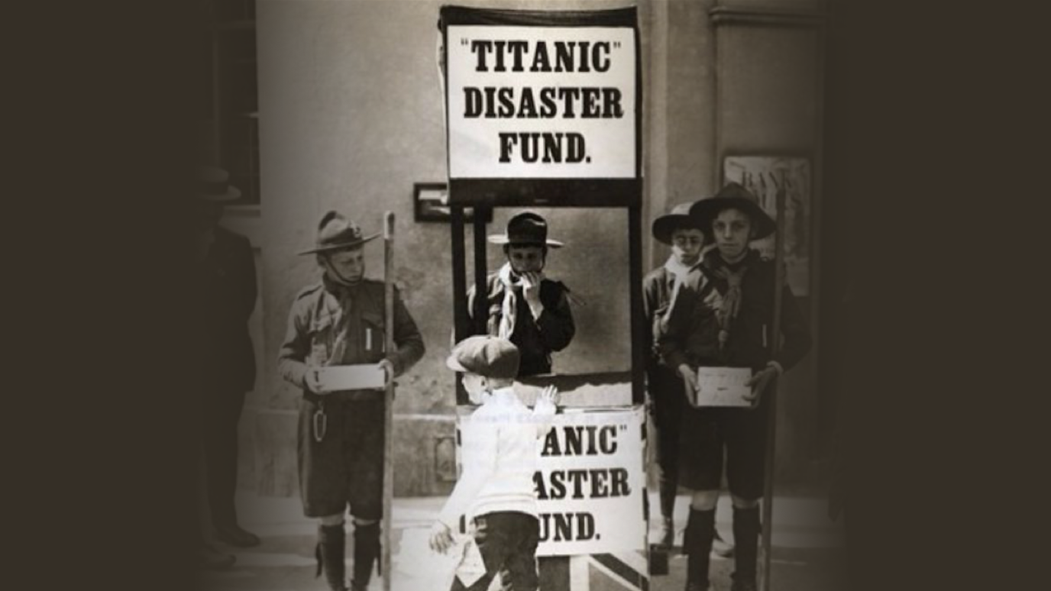
Notes:
5 years after Scouting started! The Titanic Disaster in 1912: Scout from England, raising funds for the victims.
So, it’s early in the history of our movement that Scouts started to get involved in large scale disasters.

Slide 8
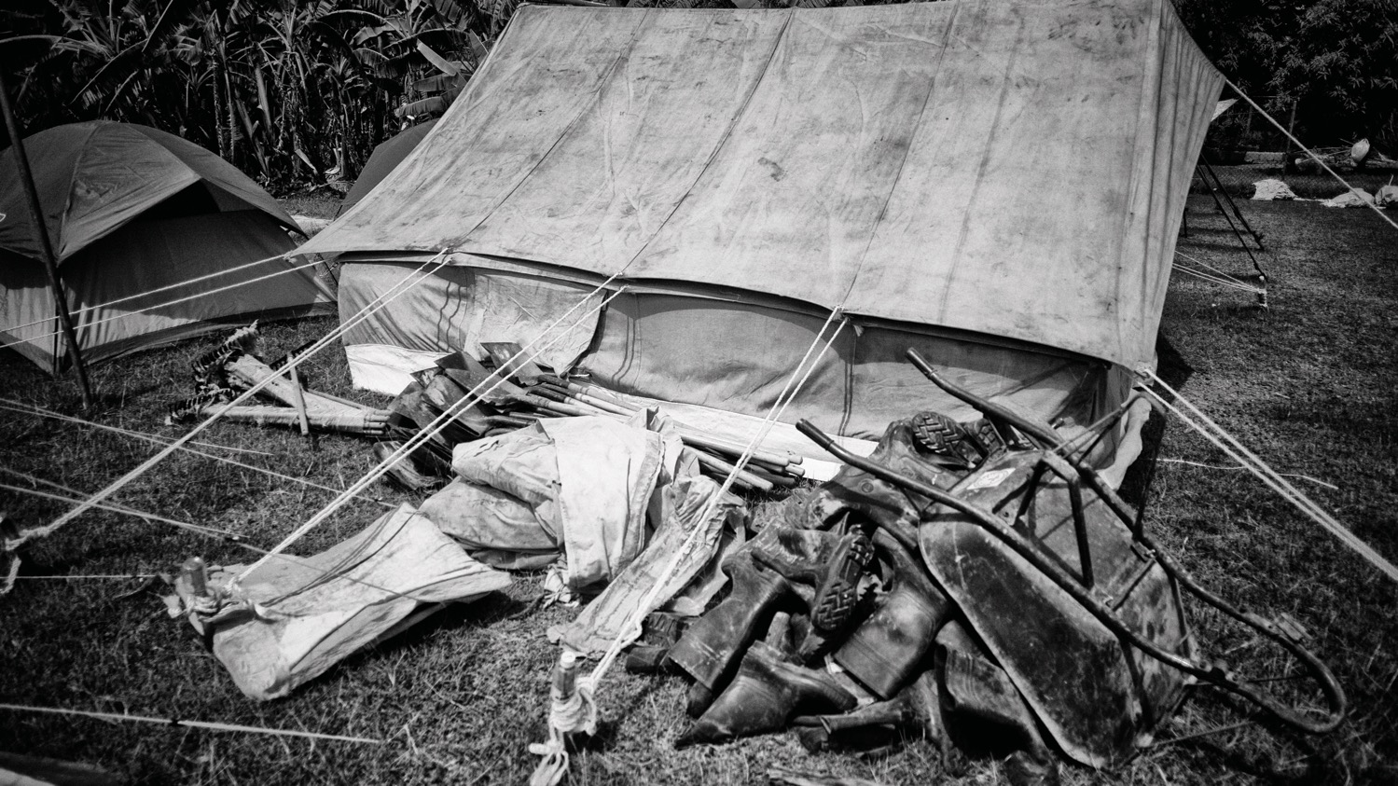
Antecedentes Históricos
Primera Guerra Mundial
Segunda Guerra Mundial
1944: The Scout International Relief Service, Reino Unido
1947: División para Personas Desplazadas del Boy Scouts International Bureau
Notes:
In WWI and WWII, there were large scale disaster related organized Scout initiatives
World War I and aftermath, Scouts from Hungary worked in refugee reception centres and refugee camps.
During WWII, 53,000 Scouts were trained to undertake National War Service jobs in Britain, serving as Police messengers, firemen, stretcher bearers …
The Scout International Relief Service was instigated in 1944 for adult Scout Leaders to provide humanitarian assistance in Europe and to deal with the aftermath of conflict. delivery of food, clothing, water, lighting, sanitation and processed displaced persons The Scouts' International Relief Service was active in refugee and displaced persons' camps in Northwest Europe, Italy, Austria, Yugoslavia, Greece, Cyprus, Syria, Palestine, Egypt and Hong Kong.
At the 11th International Conference, resolution 14/47 So the Displaced Persons (DP) Scout Division came into existence. D.P.Scout Division of the Boy Scouts International Bureau was active in Austria, Northern Italy and West Germany. The DP Scouts were registered as Scouts by the International Bureau, but had no right to vote in the International Conference.

Slide 9
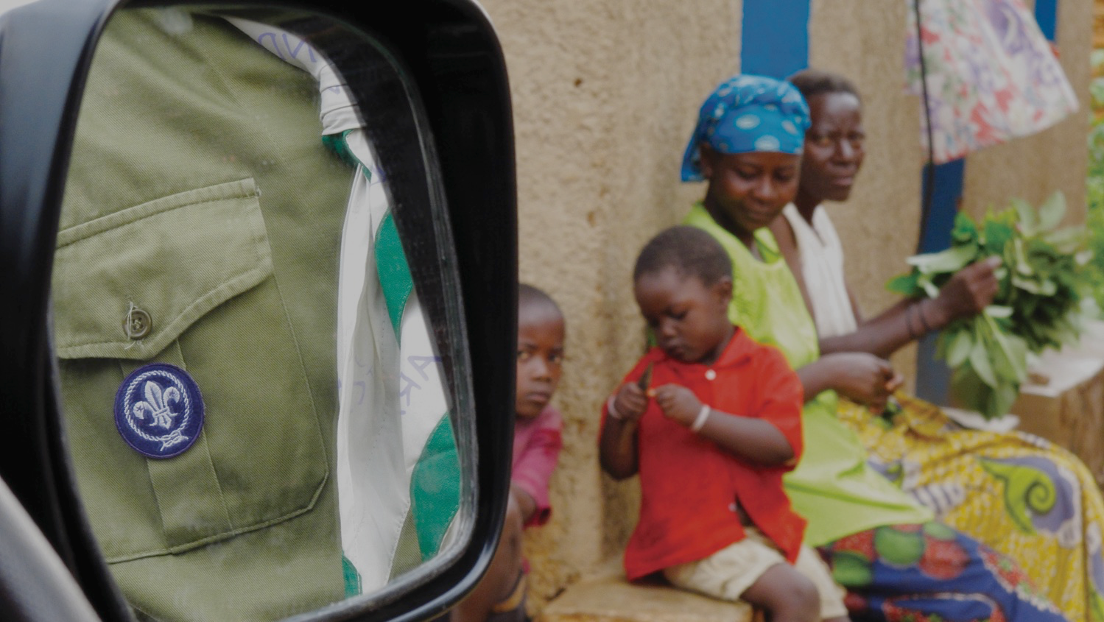
Resoluciones de la Conferencia Scout Mundial relacionadas
1939-12: Personas desplazadas
1947-14: División para PD
1953-06: Refugiados
1963-05: Ayuda Internacional
1969-07: Servicio Comunitario
1993-04: Solidaridad
1996-08: Organizaciones de Scouts en exilio
2011-17 …
Antecedentes Históricos
Notes:
Since 1939, The World Scout Conference has passed several resolutions related to Scouting and humanitarian action
One resolution urges every possible courtesy and help be extended to such Scouts and Scouters (forced to leave their native land) by the respective national association, whether the residence is to be temporary or permanent ensure that the aims, methods and principles of Scouting are accepted and practiced
Another one pays tribute to the devoted service rendered by many hundreds of Scout leaders in giving Scout training to boys displaced from their native lands and in maintaining contact between them wherever they may now be living.
In 1969, the resolution on Community development (1969-07) includes the following language: The need for thorough training for emergency service, the formation of local rescue teams and service squads prepared for such action and of proper liaison in advance with the appropriate authorities.

Slide 10
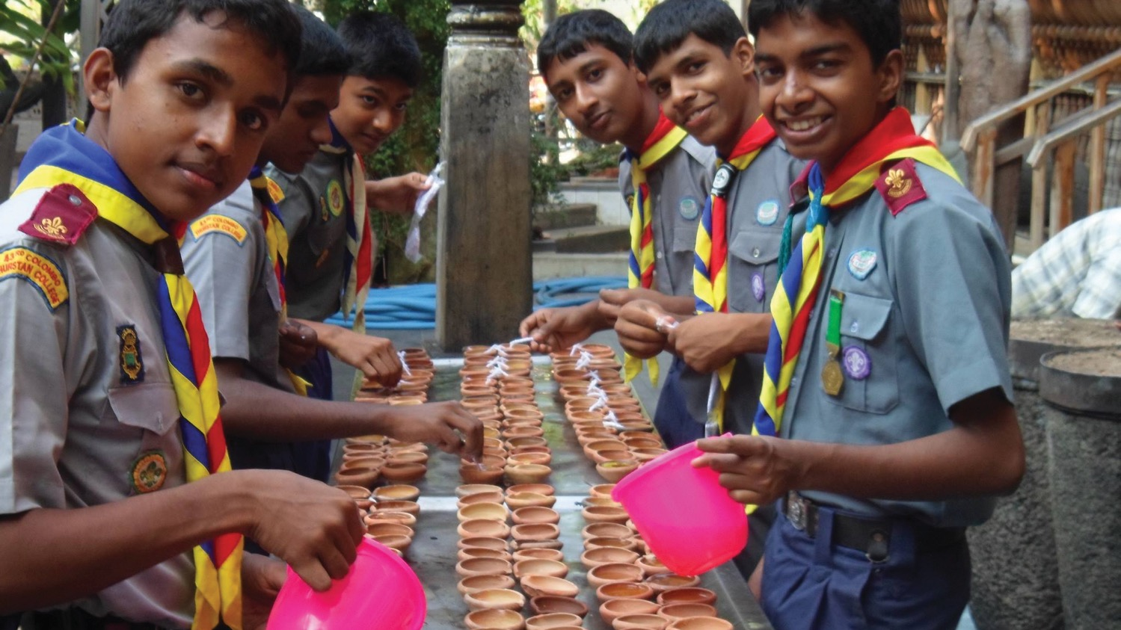
Resolución 2011-17
urge a todas las OSN a RESPONDER rápidamente a cualquier emergencia nacional o internacional
mantenerse Siempre Listos para responder
alienta a la Oficina Scout Mundial
a trabajar en Alianzas Estratégicas con agencias de ayuda
proveer Coordinación, soporte técnico y profesional a las OSN
Notes:
At the 39th World Scout Conference , Resolution 17/11 was passed
Urges all NSOs to respond urgently to any national/international emergency
Encourages the WSB to work in partnership with aid agencies to provide coordination, technical and professional support to NSOs.
That resolution is the basis for ongoing work in the field of humanitarian action in Scouting

Slide 11
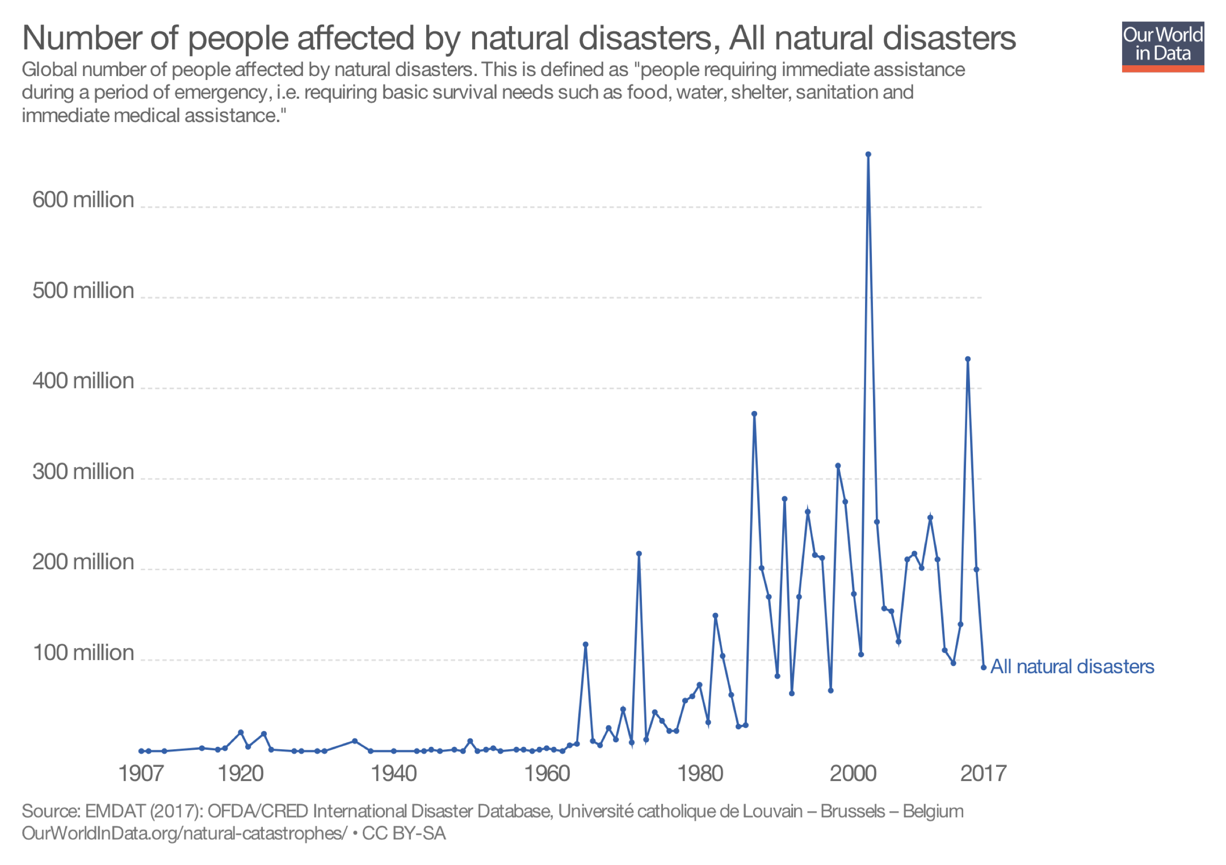
Notes:
Resolution 2011-17 and related Scouting’s initiatives is in response to what is happening in the world presently
Over the last 40 years, disasters increased in frequency, intensity and destructiveness
Climate change, conflict, urbanization and large scale migration among other forces, are increasing vulnerability and exacerbating the impact and intensity of natural disasters
The number of people affected by disaster doubled, from 102 million in 2015 to 204 million in 2016.
The total damage also increased from US$90 billion in 2015 to $147 billion in 2016.
Food security is likely to deteriorate into 2018 in northeast Nigeria, Somalia, South Sudan, Ethiopia and Yemen.
Massive increase of IDPs recorded in CAR, Congo, DRC, Iraq, Mali, and Somalia throughout the year is likely to continue rising into 2018.
Number of people in need of protection assistance is likely to increase in 2018 in DRC, Iraq, Libya, Mali, South Sudan, Sudan, and among the Rohingya population.
The world is changing rapidly and we are currently adapting as a society faced with multiple global humanitarian challenges.

Slide 12
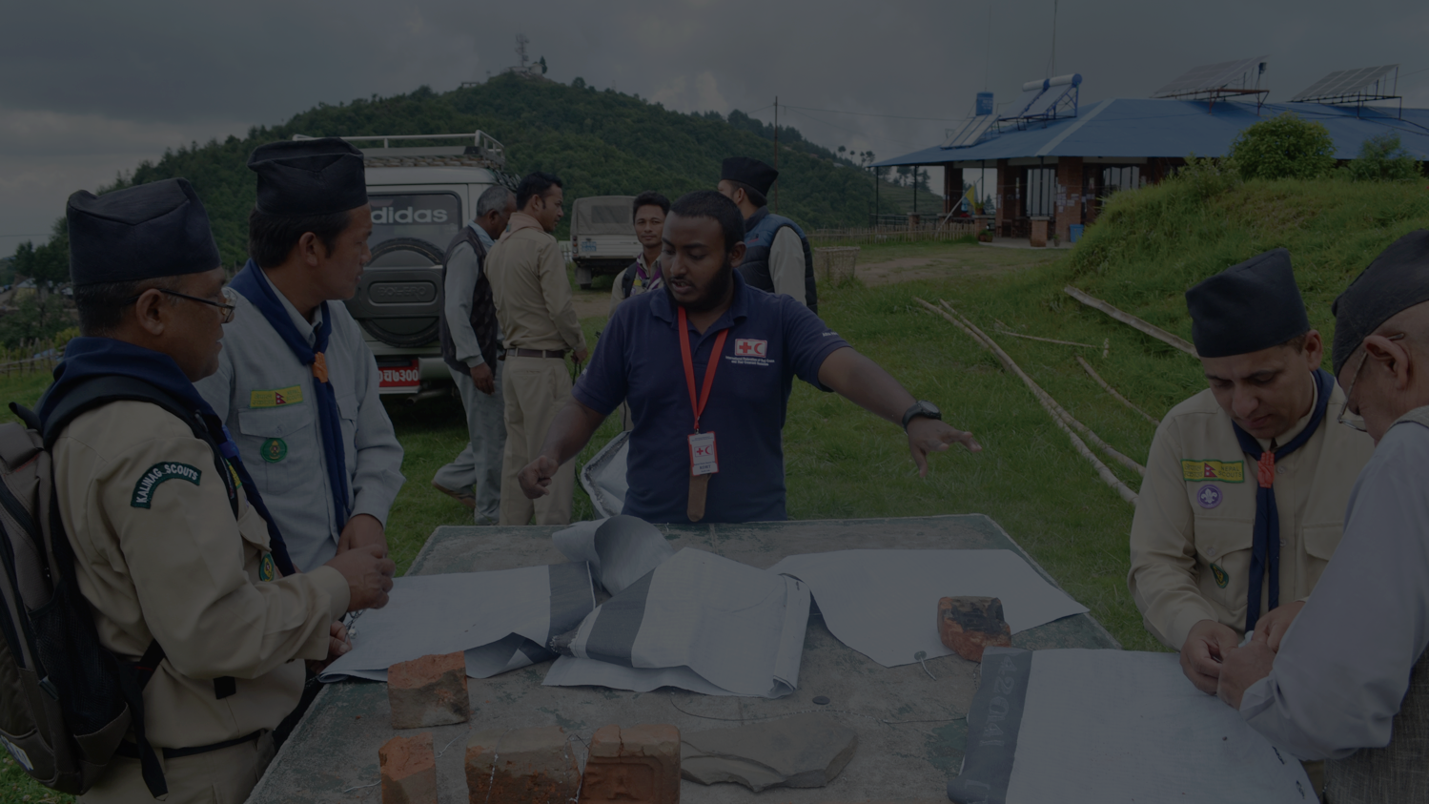
Respuesta del Movimiento Scout
Preparación
Recuperación
Respuesta
Mitigación
OSN activa en
A nivel local
A nivel de la OSN
Notes:
Most of the time, initiatives start at Local units level
Because of the presence of Scouts in most parts of the world, they are often the first responders after a disaster or rapid onset humanitarian crisis
More and more NSOs are taking an institutional approach to humanitarian action and provide coordination of local initiatives
At least 40 NSOs have been actively involved
They are active in all phases of the disaster management cycle
Some examples of recent humanitarian response by Scouts include:
The Scouts of Mexico (earthquake); The Scouts of Nepal (earthquake); The Scouts of Haiti (earthquake, hurricane); The Scouts of Japan (earthquake, tsunami); The Scouts of Liberia (Ebola epidemic); multiple European Scouts Organizations and Associations (refugee crisis); The Scouts of Bangladesh (current refugee crisis) and countless other interventions.

Slide 13

Soporte desde la OSM
Notes:
These survey results show the kind of support NSOs expect from the WSB

Slide 14
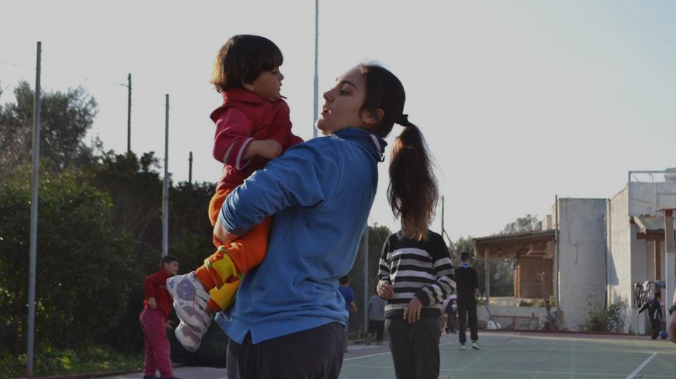
Desarrollar resiliencia a través de habilidades para la vida en el Programa de Jóvenes.
Hacer que el Movimiento Scout sea accesible para más jóvenes, independientemente de su situación actual.
Apoyar una mejor preparación y creación de capacidad de las OSN.
Desarrollar alianzas estratégicas con agentes humanitarios.
El enfoque de la
OMMS
Notes:
WOSM’s approach to humanitarian action 1
First and foremost: Reinforce and promote the life skills already present in the Youth Program to build resilience and decrease vulnerability in local communities. Consider Disaster Risk Reduction (DRR) as potentially the most effective strategy in Humanitarian Action, adopt a community-based approach to DRR.
Make Scouting accessible to more young people, regardless of their current situation, enabling them to become active citizens creating positive change in their communities, bridging humanitarian and sustainable development initiatives.
With a risk management perspective, support better preparedness of National Scout Organizations for safer, better coordinated and more effective response when necessary.
Develop partnerships with other humanitarian actors to leverage their expertise, particularly during response and recovery, to complement our contribution while positioning Scouting as a key stakeholder in Humanitarian Action.

Slide 15
Posicionar el Movimiento Scout como parte interesada clave.
Abogar por la educación no formal en emergencias.
Llevar el Movimiento Scout a los jóvenes en crisis humanitarias.
Agilizar el apoyo de la OSM a las OSN involucradas en AH.
El enfoque de la
OMMS
Notes:
WOSM’s approach to humanitarian action 2
Advocate for non-formal education in emergencies and bring Scouting to young people in humanitarian crisis (refugees, migrants, stateless young people) to facilitate their integration in the host community, build resilience against future disasters and grow Scouting for a Better World.
Streamline WSB’s support to NSOs involved in Humanitarian Action through the Service Model with rapid response and a coordinated approach between NSOs, regional and global support centres.

Slide 16
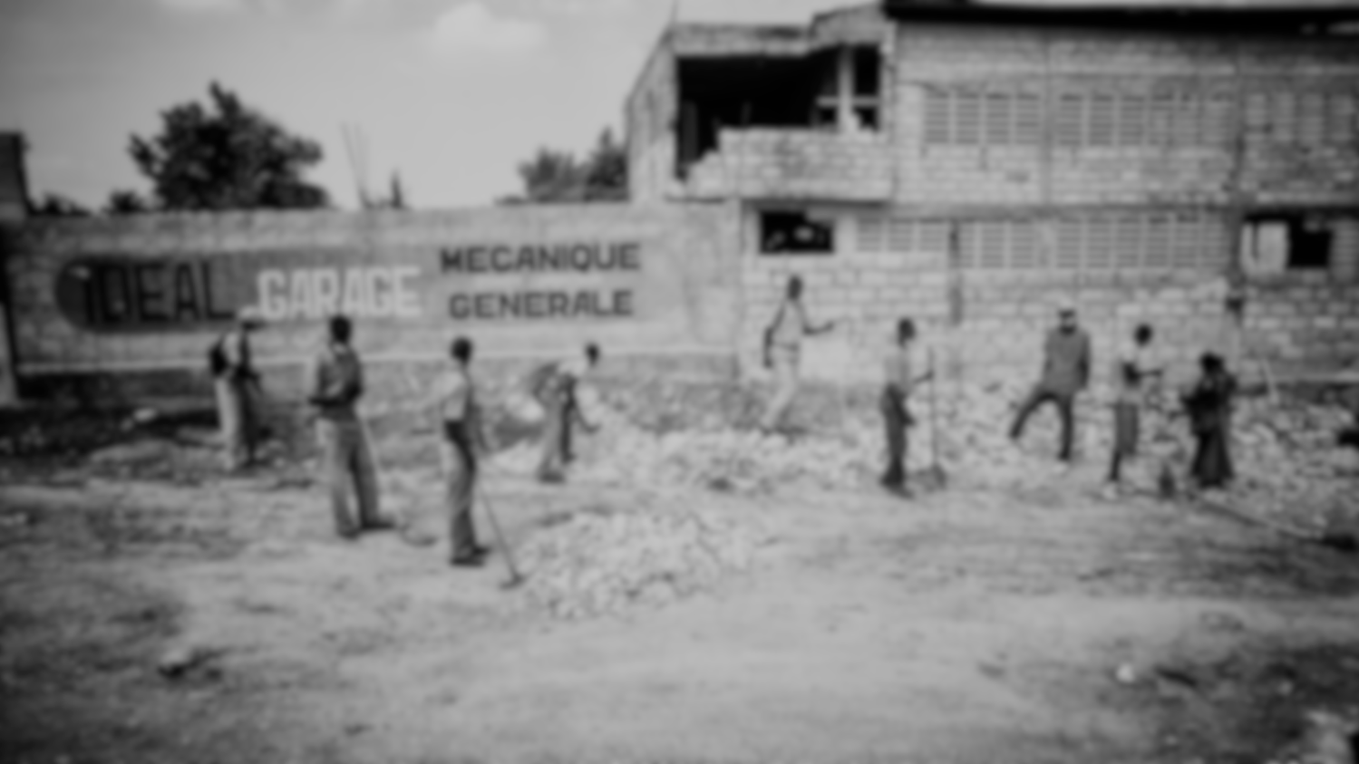
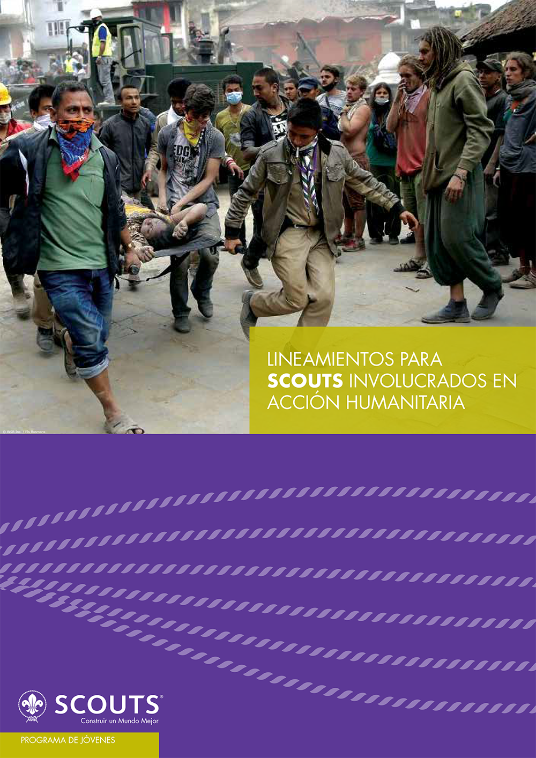
Lineamientos para Acción Humanitaria
Notes:
WOSM’s Guidelines for Scouts involved in Humanitarian action offers ideas on how to get involved in Prevention, Mitigation, Preparedness, Response, Recovery while keeping focus on the educational mission of Scouting.
The guidelines highlights:
the need to recognise and promote the Humanitarian Action happening within the Youth Program
NSOs/NSAs are essentially building resilience and reducing vulnerability in the local communities. Prevention and mitigation are intrinsically linked to the educational mission of Scouting
need for better preparedness
no role in leading the coordination during response
non-formal education and Scouting can strengthen the coping capacities of young people against future disasters
Scouting: key stakeholder in Humanitarian Action

Slide 17
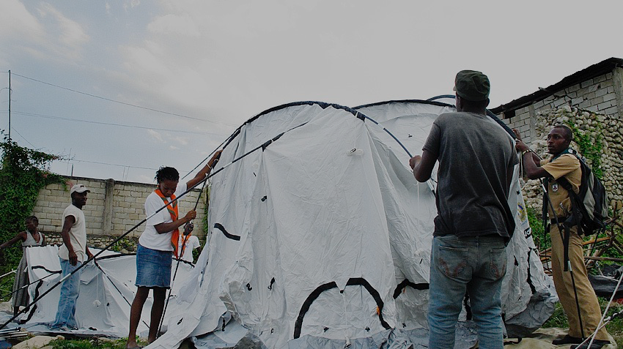
Próximos pasos
Programa de Jóvenes
Preparación y respuesta a crisis
Movimiento Scout en entornos humanitarios
Alianzas Estratégicas
Financiamiento
Coordinación
Notes:
Youth Program
Develop and implement Disaster Risk reduction and Emergency response actions in Youth Programme
Develop a toolkit to help NSO integrate humanitarian action in the Youth Programme
Continue to collect and share best practices
Support NSOs to ensure their youth programmes encourage young people to actively and safely respond in emergency situations in their communities.
Preparedness
Raise awareness on preparedness at all levels of our organisation
Support NSOs in establishing emergency planning
Support NSOs in capacity building and volunteers training
Response
Support NSOs in volunteers mobilization and coordination for safe interventions
Encourage partnership with specialised humanitarian actors during response
Establish response mechanism and volunteers network at all levels
Scouting in humanitarian settings
Deliver Scouting to young people affected by natural or human-induced disasters by supporting NSOs
Investigating possible programmes and partnerships to assist people who are seeking refuge from natural or human induced disasters and integrating them into the host community through Scouting
Encouraging NSOs to commit to recognise stateless people or people affected by natural or human induced disasters and include them in all aspects of Scouting
Advocate for and ensure education (our mission) is given priority in humanitarian crises
Partnerships
Develop global strategic partnerships
Fundraising
Facilitate national partnerships
Ensure visibility of Scouting in Humanitarian Action and send clear message to existing and potential partners about our capacity and unique position as the largest Youth Movement and as key Stakeholder
Coordination
Streamlining WSB’s support to NSOs engaged in Humanitarian Action during and after emergencies

Slide 18

“Siempre Listo... El significado del lema es que un Scout debe prepararse pensando previamente y practicando cómo actuar en cualquier accidente o emergencia para que nunca lo tome por sorpresa.”
Baden Powell

Slide 19
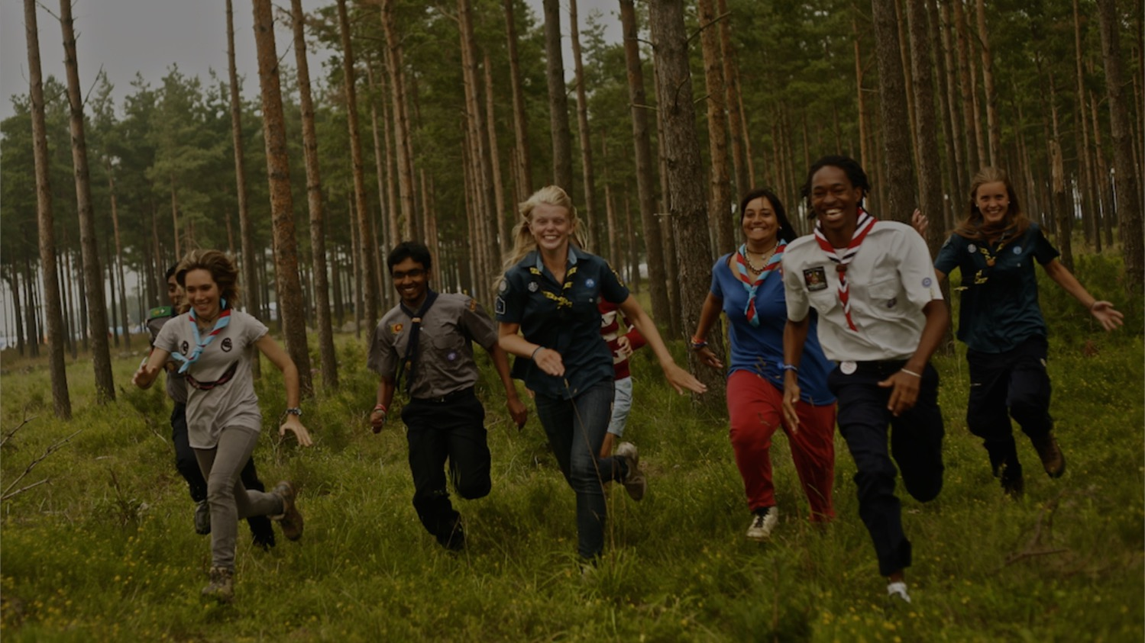
Gracias
Notes:
To seek further support, share feedback, and ask questions related to humanitarian action, contact the World Scout Bureau at educationalmethods@scout.org.

